Slide 1

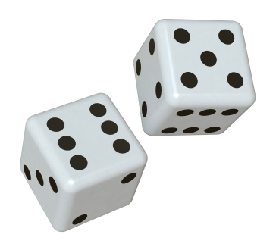

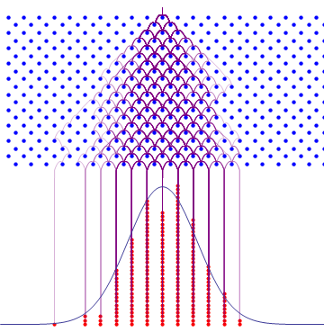
Probability and Statistics

Slide 2

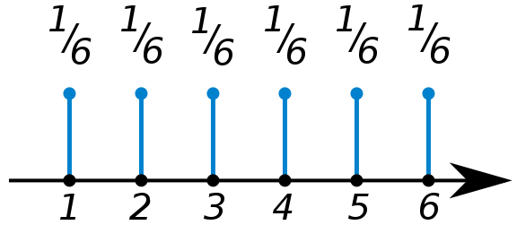
Discrete Probability Distributions
P(n) – Probability of observing the nth discrete value
P(n) =
n =
Normalization
Mean or “expected value”
<n> = 3.5

Slide 3

Binomial Distribution
Probability an event A occurs v_{A} times out of N trials, given the prob. of seeing it once is P(A).
N= 60
N= 600
P(A)=1/6
P(A)=1/6

Slide 4
Measuring Probability – Poisson Statistics
“Counting” experiments.
Uncertainty in Measured Probability
Measured Probability
N= 60
N= 600
P(A)=1/6
P(A)=1/6
“Statistical Convergence”

Slide 5


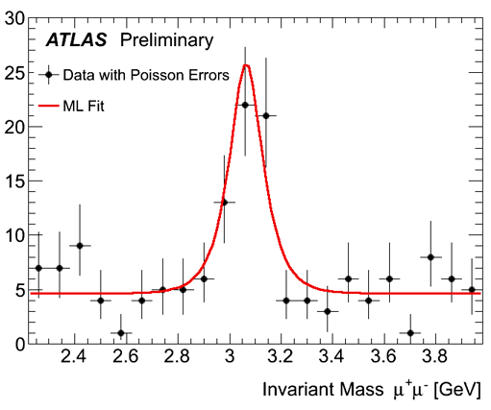
Measuring Probability – Poisson Statistics
“Counting” experiments.
http://www.bbc.com/news/world-us-canada-43818752

Slide 6
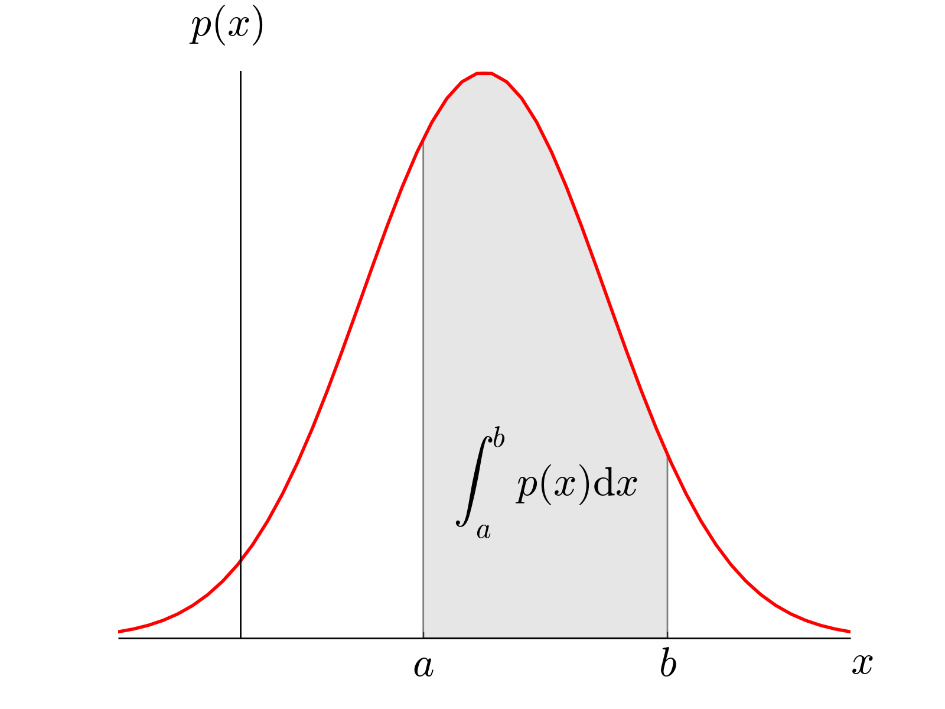
Continuous Probability Distributions
ρ(x) – Probability Density Function
Probability x is between a and b:

Slide 7
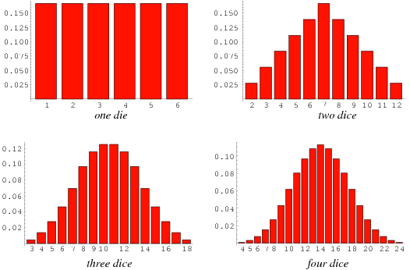
Central Limit Theorem
http://mathworld.wolfram.com/Dice.html

Slide 8
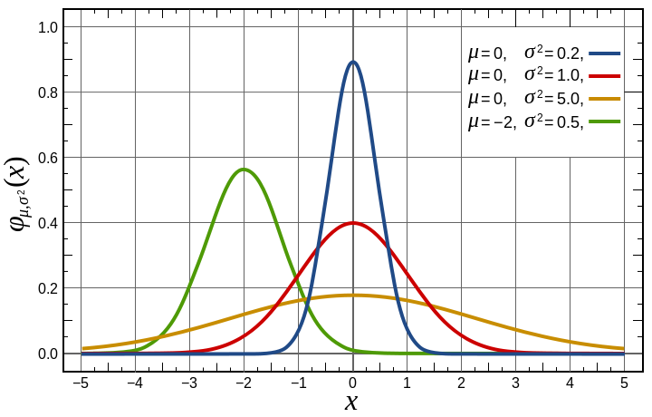
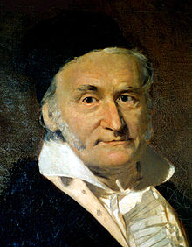
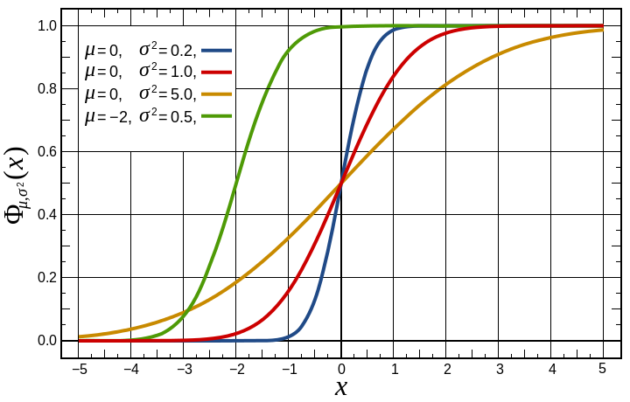
Gaussian Distribution
Gaussian PDF
Central Limit Theorem – For large N, most distributions become Gaussian
Gaussian CDF
Carl Friedrich Gauss (1777-1855)

